Slide 1


Attentive AI: Intelligent Driver Drowsiness Avoidance System

Slide 2
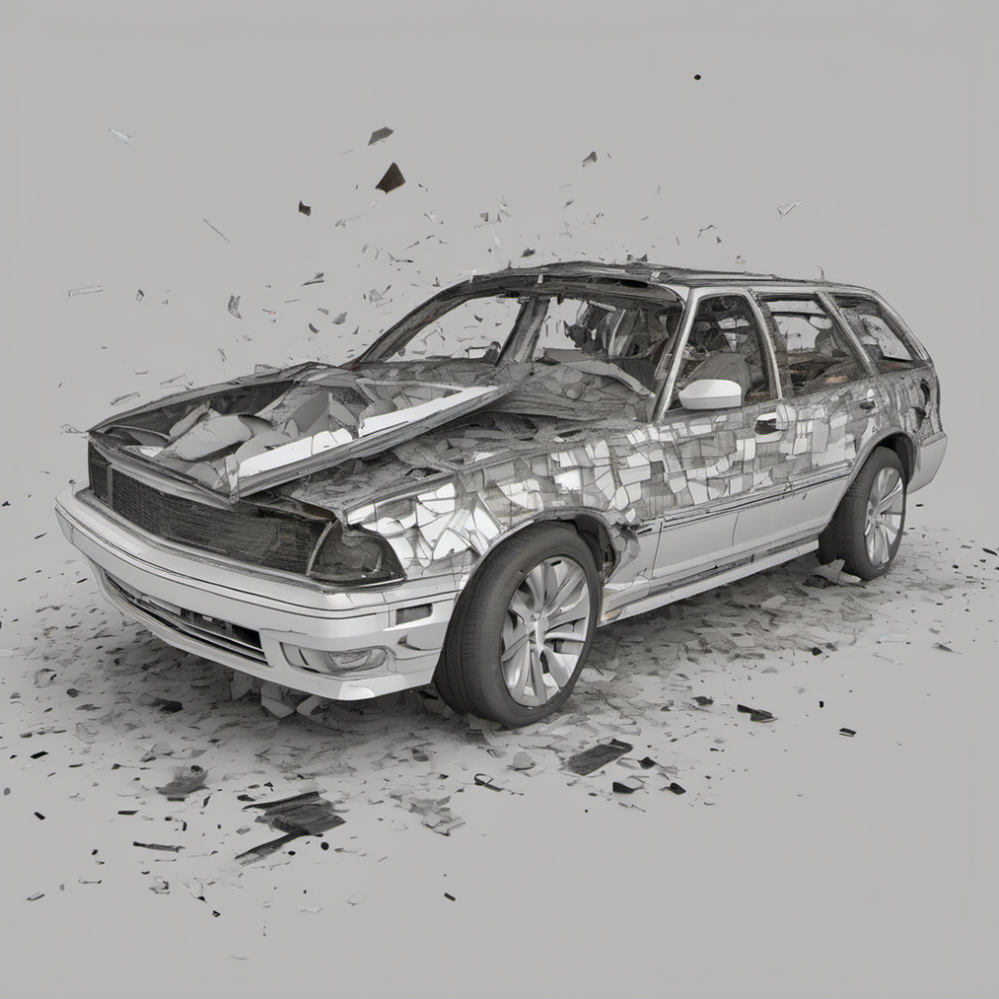
Problem
Globally, driver drowsiness contributes to around 1.25 million road deaths and up to 50 million injuries each year*
*World Heath Organization

Slide 3



Our Vision
Problem 1
Reduce the fatal accident due to driver drowsiness
Problem 2
Enjoy the ride! You are alone but not lonely
Problem 3
Knowledge extension

Slide 4
Solution Concept
Different stages of interactions to keep driver awake
L1
L2
L3
L4
L1: Enjoy the ride
Who wants to be a millionaire?!
L3: Family Feud
L4: Annoy until you obey
Active engangement of the GenAI with longer driver response time
Active engangement of the GenAI with short driver response time
Active engangement of the GenAI with short driver response time
Haptic feedback and incomfortable audio
Turn ON the driver’s favourite music

Slide 5


Our Solution

Slide 6
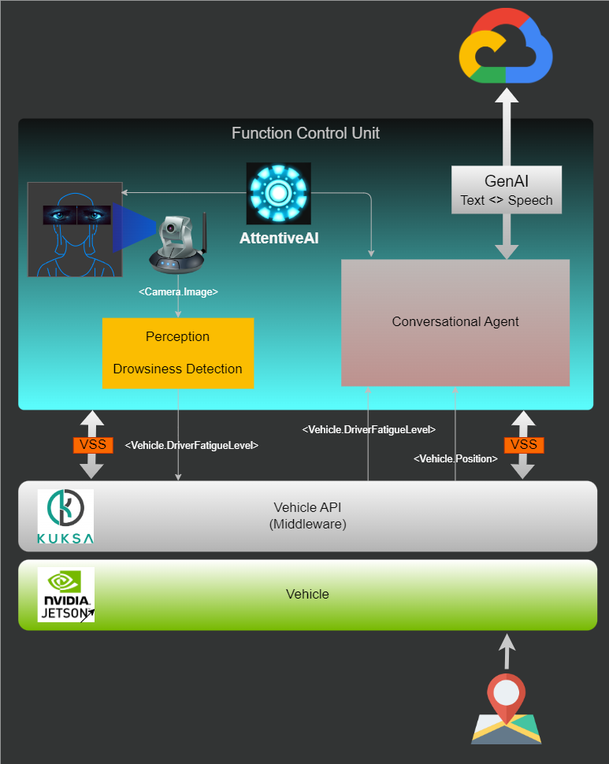
System Architecture

Slide 7
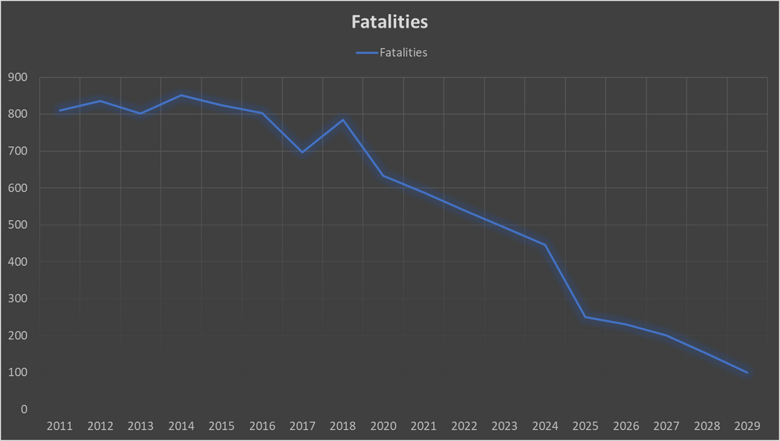
Objective

Slide 8
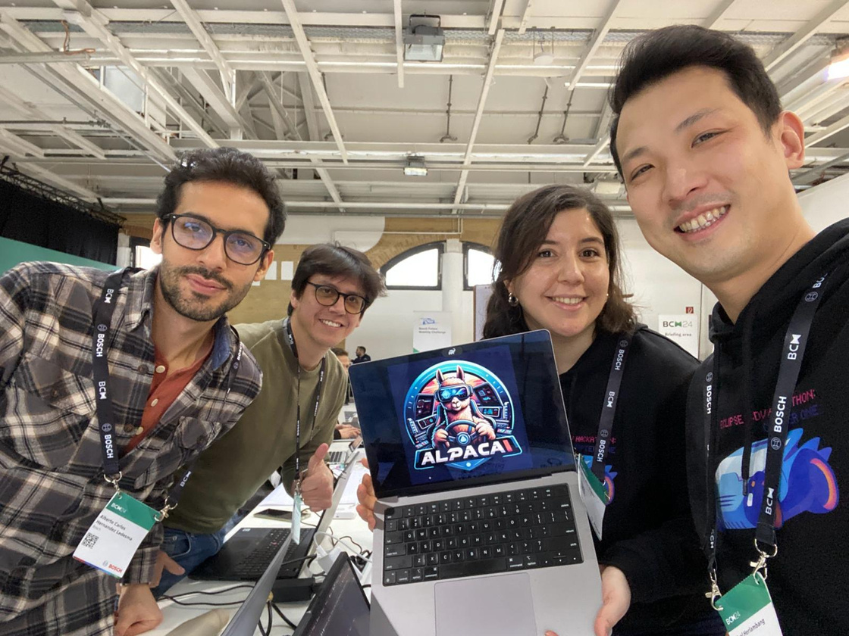
The Team

Slide 9

Thank you
Contact Us
Zehra Nur Olgun
Afrizal Herlambang
Sergio Roa-Ovalle
Alberto Carlos Hernandez
contact@alpacai.com

